Slide 1

TextBlob: Simplifying NLP
TextBlob is an intuitive Python library designed to make Natural Language Processing (NLP) tasks a breeze. Let's dive into its features and see how it can revolutionize NLP workflows.

Slide 2
Text Processing and Analysis Made Simple
Tokenization
N-gram Creation
TextBlob's tokenizer splits documents into sentences or words efficiently. Customize your tokenizer to suit the task at hand.
Create word n-grams to uncover import patterns in your document. TextBlob allows for trigram and bigram generation.
Word Frequencies
Stopwords
Find out which words appear the most frequently. Create bar charts and word clouds to visualize your findings.
Remove noise from your documents. TextBlob makes it easy to remove stopwords and focus only on important words.

Slide 3


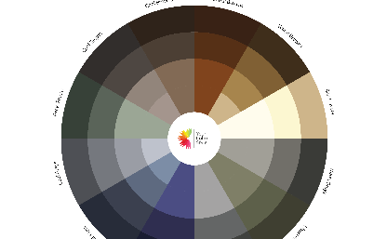
Sentiment Analysis and Polarity Detection at Your Fingertips
Positive Sentiment Analysis
Negative Sentiment Analysis
TextBlob can analyze text for positive sentiment. From social media posts to movie reviews.
Negative sentiment analysis is just as important. Identify negative feedback on your product or service before it's too late.
Neutral Polarity Detection
For nuanced opinions, TextBlob has the ability to detect a neutral sentiment and provide an objective analysis.

Slide 4
Enhance Your Text with Part-of-Speech Tagging and Noun Phrase Extraction
1
Part-of-Speech Tagging
Add more value to your NLP tasks with TextBlob's POS tagging. Identify parts of speech (nouns, verbs, adjectives) and enhance document analysis.
2
Noun Phrase Extraction
Identify and extract noun phrases with ease. Use this feature to create summaries of long documents or to extract important information from a corpus.
3
Semantic Similarity
Discover the importance of measuring similarity between documents. Use TextBlob's tools to analyze and compare your text with other documents.

Slide 5
Translation and Detection Made Easy
Language Translation
Language Detection
Translate your text into another language with ease. Carve out your niche in global markets easily and effectively.
Automatically detect which language your content is written in. Great for multi-language websites and document repositories.

Slide 6
Language Translation
Multilingual Communication: Language translation capabilities enable you to connect with diverse audiences by offering content in their preferred languages. This fosters better communication and engagement across global markets.
Cultural Sensitivity: Accurate translation ensures that your message is conveyed with cultural nuances intact. This prevents any misunderstandings or unintentional offense that can arise from mistranslations.
Efficient Content Localization: Language translation is essential for localizing your content, adapting it to specific regions or countries. This includes websites, apps, marketing materials, and more, making your offerings resonate better with local audiences.
Global Reach and Growth: By breaking language barriers, translation opens doors to new business opportunities in untapped markets. Your products or services can gain wider adoption, driving business expansion on a global scale.

Slide 7
Language Detection
Effortlessly identify the language of a given text with precision, enabling seamless interactions with multilingual audiences.
Automated Identification: Language detection automates the process of identifying the language of a text, reducing manual effort and speeding up language-related tasks.
Multilingual Content Strategy: Accurate language detection helps businesses tailor their content strategies to reach specific language-speaking audiences, improving engagement and relevance.
Customer Support Optimization: Implementing language detection in customer support systems ensures that users receive assistance in their preferred language, leading to better customer satisfaction.
Global Insights: By detecting the languages users engage with, organizations can gain insights into audience preferences and adjust marketing efforts accordingly.
Efficient Data Handling: Language detection facilitates categorizing and organizing multilingual data, enhancing data management and analysis capabilities.

Slide 8
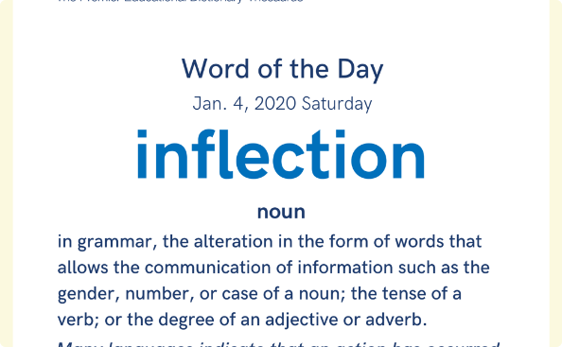
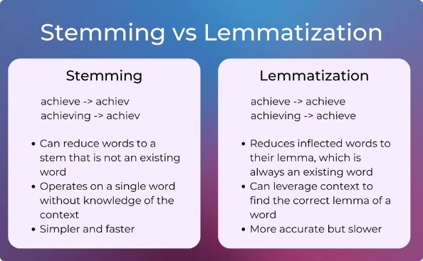
Inflection and Lemmatization with TextBlob
Inflection
Lemmatization
Inflection enables you to generate different verb conjugations. This feature can be great for learning languages or modifying the style of your text.
Lemmatization transforms words into their root form. This is important for text normalization and information retrieval.

Slide 9

Check Spelling and Correct Text Data with Ease
1
Spell Checking
Ensure that your text is free of errors with TextBlob's spell checker built on top of PyEnchant. Correct misspelled words over your entire corpus at once.
2
Correction
Correct common spelling mistakes in your documents with TextBlob's correction capabilities. Perfect for quick fixes and automated workflows.

Slide 10
The Future of TextBlob: Enhancements and Adaptations
Active Community
Advanced Integration
Improved Performance
TextBlob's open-source code has led to an active community of contributors that continue to improve the library.
Integrate TextBlob with other powerful Python modules like NLTK and Scikit-Learn to take your NLP workflow to the next level.
The future of TextBlob will bring about improved performance and faster computation times to make NLP a breeze even for large corpora.

Slide 11

Conclusion
TextBlob is an exceptional library that makes Natural Language Processing tasks a breeze. It's features allow for comprehensive text analysis with minimal code, making it a must-have for today's NLP workflow.

